Slide 1


St Mary’s Church of England Junior Academy
Welcome to St Mary’s Church of England Junior Academy!
Year 3 Transition Event, Monday ^{17th} June 2024

Slide 2
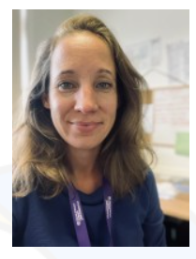
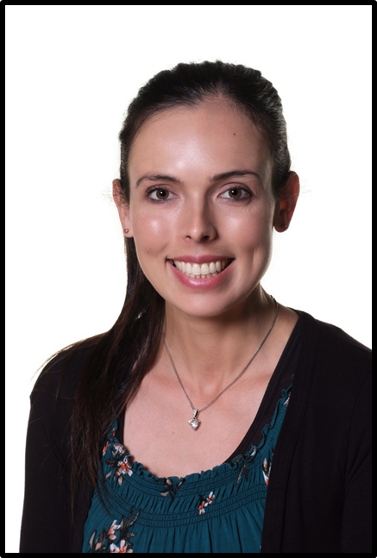
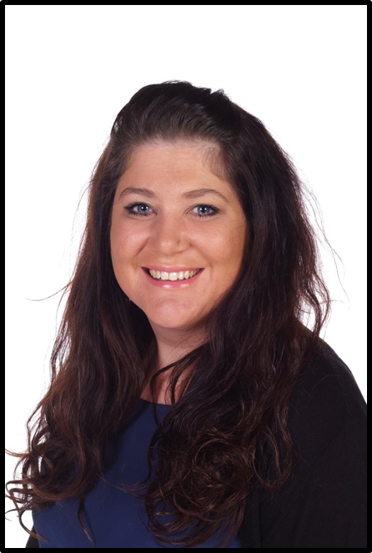
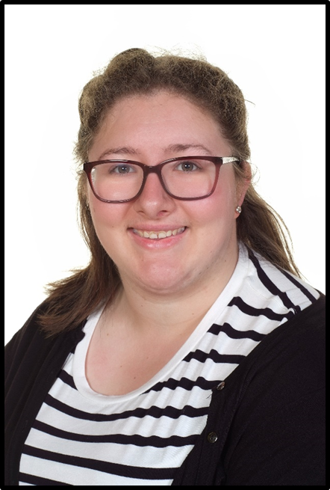
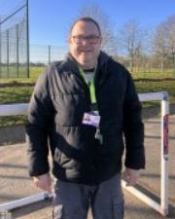
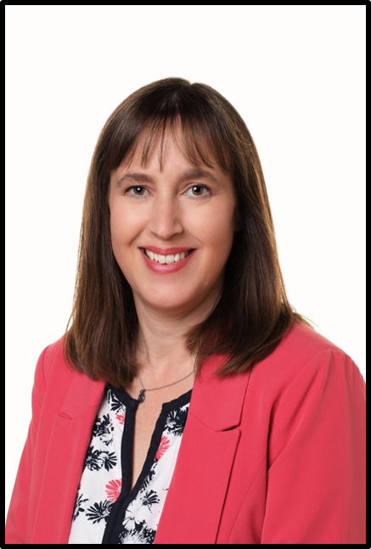
Key staff across the school
St Mary’s Church of England Junior Academy
Miss Richardson Head Teacher | Miss Laurie Assistant Headteacher & SENDCO | Mrs Dale Pastoral Lead and Safeguarding Lead | Miss Maher Pastoral Assistant | Mr Leek Pastoral Assistant | Mrs Drake School Office

Slide 3
Class Structure 2024 - 2025
St Mary’s Church of England Junior Academy
Skylarks
Year 3
Woodpeckers
Year 3
Robins
Personalised Learning Curriculum
Notes:
Numbers wise we were faced with a decision between having classes of over 32, but not enough to split into 2 separate class with a qualified teacher in each. Therefore we research other options and we felt that children’s needs would be best met with this structure.
Another benefit of the new structure is that we are able to introduce a new class: London, which will have fewer pupils in and will be used to meet the needs of pupils

Slide 4
Our School vision
At St Marys, we nurture respectful and responsible global citizens who contribute to their communities with compassion and courage.
Young minds grow with God’s love and an ambitious curriculum for all, to enable everyone to flourish as they ‘soar on wings like eagles’ and ‘live life in all its fullness’.

Slide 5
Our Values
Respect shapes us: we value ourselves, each other and the world, we celebrate and understand difference
Responsibility enhances us: we take responsibility for ourselves, our learning and our actions. We always strive to make the impossible possible
Community and love guides us: we are kind and supportive and we have a love of learning. We are good citizens who play a positive role in our communities.
Courage builds us: we are resilient, we work hard, we practise and we learn from our mistakes as we grow in the world around us. We stand up for what is right even in the face of adversity.
Ambition drives us: we value knowledge and skills, we accept challenges and celebrate achievements. We persevere to overcome challenges and barriers enabling us to show resilience.
Nurture and love protects us: we openly show love and kindness to our peers, adults and community. We are not afraid to talk about our mental health, emotional or physical needs with trusted adults so we can be supported to be the best version of ourselves.

Slide 6

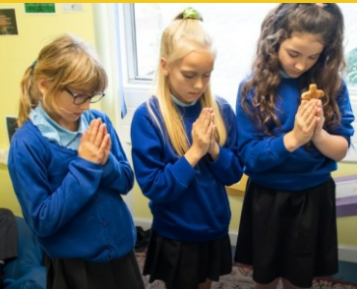
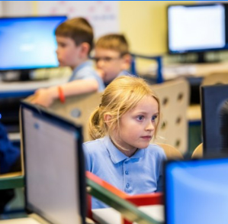


What does a typical school day at St Mary’s look like?
St Mary’s Church of England Junior Academy
Our school day starts at 8:40am and finishes at 3:10pm.
8:40 - 8:45 | Gates open and children line up on playground
8:45 – 8:55 | Registration
8:55 - 9:10 | Collective Worship
9:10 – 10:30 | English
10:30 – 10:45 | Break on Lower KS2 playground
10:45 – 12.00 | Maths (3 part lesson)
12:00 – 12:50 | Lunch and break
12:50 – 1.15 | Reading less
1.15 - 3.00 | Topic and Non-Core Subjects
3.00 - 3.10 | Whole class story
3:10 | Home time – Collection from classroom doors

Slide 7
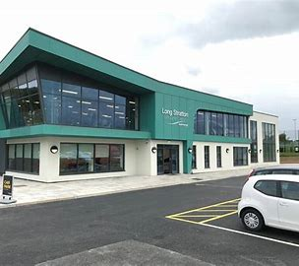
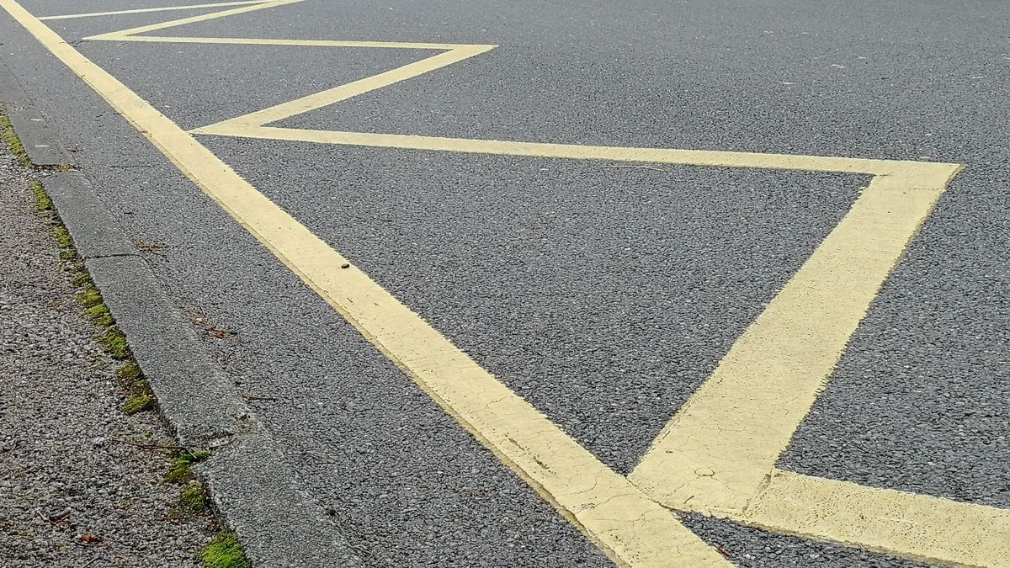
Morning Drop-Off
St Mary’s Church of England Junior Academy
There are always two members of staff on the gate morning and afternoon to welcome you. If you have any questions, queries or concerns please come and talk to us. We welcome parents onto the playground to hand your child over to their teacher.
If arriving by car, please ensure you park either in the Leisure Centre Car Park or you use one of the laybys outside the school.
DO NOT PARK OR STOP TO DROP-OFF ON THE ZIGZAG LINES IN FRONT OF THE SCHOOL GATES This is for the safety of your own and other children.

Slide 8
Talking with teachers
St Mary’s Church of England Junior Academy
Our class teachers are keen to work closely with you. Staff are often available to pass on quick messages at the start and end of the school day.
However, if you would like to have a discussion with a teacher, please book an appointment via the School Office or by emailing the teacher directly. Please note, you may not always receive an immediate response but we will always endeavour to reply as soon as we can.
Parent consultation meetings are also offered each term alongside additional SEND parent meetings.

Slide 9
Our curriculum
We have a mastery approach for all subjects.These assume:
Everyone can learn
Ambitious curriculum
Make connections between learning
Teachers develop specialist knowledge and pedagogy
Small steps when teaching
Language is explicitly planned for
Scaffolding is provided so all can achieve

Slide 10






Curriculum: English
St Mary’s Church of England Junior Academy
We are using CUSP curriculum for reading and writing. You can find our long term plans on the websites.
Narrative writing
Persuasive letter
Poem
News report
Non-chronological
report
Diary writing
Explanation text
Poetry
Poetry
Historical report
Narrative writing
Newspaper report
Poem
Poetry
Biography
Notes:
Mastering English is a strategy that provides a progressive and structured approach to teaching reading and writing to primary aged pupils.
This bespoke curriculum has been designed for St Benet’s Trust Schools with approaches adapted from T4W, Power of Reading and the previous National Literacy
Strategies

Slide 11




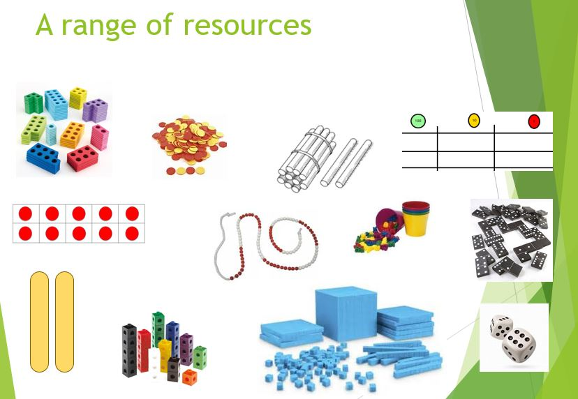
Curriculum: Maths mastery approach
St Mary’s Church of England Junior Academy
*We use the Power Maths approach which ensures consistent curriculum coverage
and used alongside wider activities to support, stretch and challenge all children.
*Children benefit from concrete, pictorial and abstract methods to build a fluency
and confidence.

Slide 12
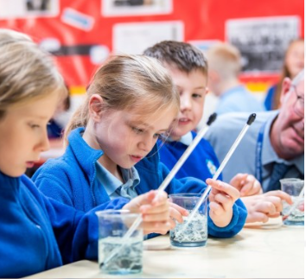
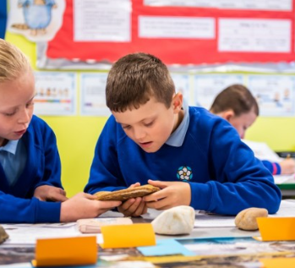





Curriculum: Science.
St Mary’s Church of England Junior Academy
Science is taught in topic blocks, with a project-based approach.
The successful, cross-curricular approach we take at St Mary’s results in a fun, engaging, high-quality science education, that provides children with the foundations and knowledge for understanding the world.

Slide 13
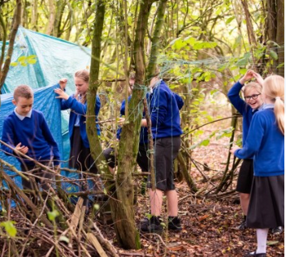




Curriculum: History and Geography.
St Mary’s Church of England Junior Academy
Our Ark Mastery Geography curriculum provides
a knowledge-rich, comprehensive curriculum that
has been strategically sequenced to ensure a broad and effective learning experience for all pupils.

Slide 14
Special Education Needs Provision
St Mary’s Church of England Junior Academy
Depending on the individual needs of the child, we will provide:
High Quality Teaching
An adapted or personalised curriculum
Access to specialist equipment such as ICT and other Tools for Learning
In-class support from a TA or other support staff
Group-intervention programmes
One-to-one intervention programmes
Special Access Arrangements for exams/tests
Assessment from a specialist professional such as an Educational Psychologist or Specialist Learning Support Teacher
Delivery of programmes set by specialist services, such as a Speech and Language Therapist or Occupational Therapist

Slide 15
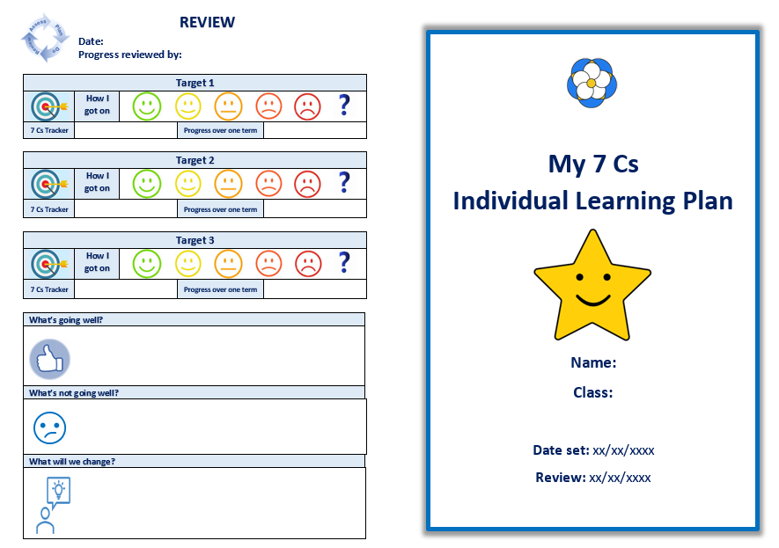
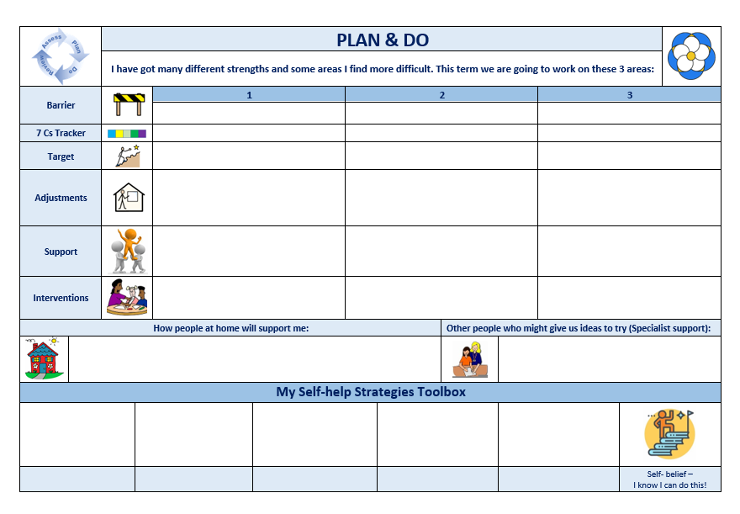
Special Education Needs Provision
St Mary’s Church of England Junior Academy
Miss Laurie, our SENCo, works closely with parents and with class teachers and TAs to identify the needs of pupils with SEND and the provision needed to meet these needs.
Please do not hesitate to contact me or come to one of the SENDCo Surgeries I will be hosting next year, if you are concerned about your child and feel that they may have a special educational need or disability.
For pupils with SEND we implement the graduated approach of assess, plan, do, review through our termly Support Plans

Slide 16

Pastoral Support
St Mary’s Church of England Junior Academy
Mrs Dale is our Pastoral Lead and Safeguarding Lead who works with Miss Maher and Miss Leek. They are available to work with pupils and families to support a whole range of areas including mental health support, financial guidance, family support and sign-posting to other support services.
She can be contacted by email: tdale@stmarys.stbenets.org or via the school Office (01508 530459).

Slide 17

Homework
St Mary’s Church of England Junior Academy
Homework is given out each week and consists of: spellings, times-tables practice, daily reading and one project-based piece of homework per half term.
All children will be provided with login details for TT Rockstars and Google Classroom in September.
If your child is experiencing significant difficulty completing their homework, please arrange to speak to their class teacher.

Slide 18

Free School Meals & Pupil Premium Application
St Mary’s Church of England Junior Academy
Families who receive certain benefits may be eligible for free school meals. Your child is eligible for free school meals if you’re in receipt of one of the following benefits:
Universal Credit with an annual net earned income of no more than £7,400.
Income Support
Income-based Jobseeker’s Allowance
Income-related Employment and Support Allowance
Support under Part 6 of the Immigration and Asylum Act 1999
The guarantee element of Pension Credit
Working Tax Credit run-on (paid for the four weeks after you stop qualifying for Working Tax Credit)
Child Tax Credit (with no Working Tax Credit) with an annual income of no more than £16,190

Slide 19


Lunchtime
St Mary’s Church of England Junior Academy
Please ensure you select your child’s lunch a week in advance.
Mrs Drake can support you with setting up your parent mail.
Alternatively, pupils can bring their own healthy lunches from home.
PLEASE DO NOT SEND YOUR CHILD WITH NUTS OR FOOD CONTAINING NUTS AS SOME PUPILS MAY HAVE ALLERGIES
Packed lunches should not include:
• Chocolate bars or sweets
• Fizzy drinks
• Hot food

Slide 20
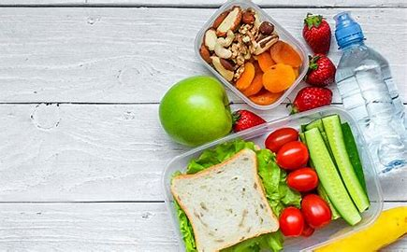
Healthy Snacks
St Mary’s Church of England Junior Academy
All children in Reception and KS1 receive a free piece of fruit or vegetables everyday as part of the Governments School Fruit and Vegetable Scheme. (This would have been provided at their Infant school).
As children move up into KS2, if they wish to have a break time snack, they are required to bring in something from home.
This should be a portion of fruit or vegetables. It should NOT be crisps, biscuits, chocolate or similar.
All children may have a water bottle in school which should hold plain water only. Sugary drinks and flavoured water will be sent home and children offered an alternative during learning time.

Slide 21
Extra Curricular Clubs
St Mary’s Church of England Junior Academy
Every half term the after school clubs change:
Here are a few we have offered this year:
Basketball
Football
Bounce
Multi sports
Dance
Ukulele
Taekwondo
These are £4 a session and run until 4:15pm. We will send out all the booking information via ParentMail

Slide 22
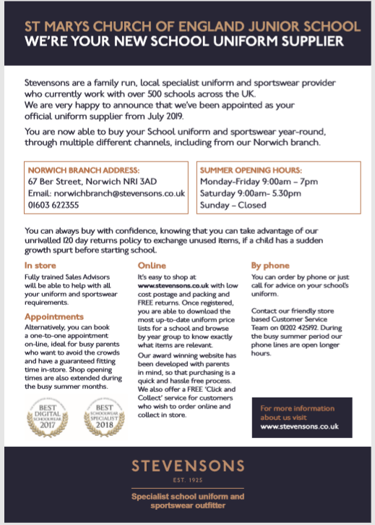
School Uniform
St Mary’s Church of England Junior Academy
It is our school policy that all children wear school uniform when attending school, or when participating in school-organised events outside normal school hours. We ask children to wear their shirts tucked into their skirts or trousers and to take pride in their personal appearance.
Some items of uniform can be bought from the school uniform outfitters Stephenson’s, whilst others are easily available, at very competitive prices, at local supermarkets.
PLEASE MAKE SURE ALL ITEMS ARE NAMED!

Slide 23
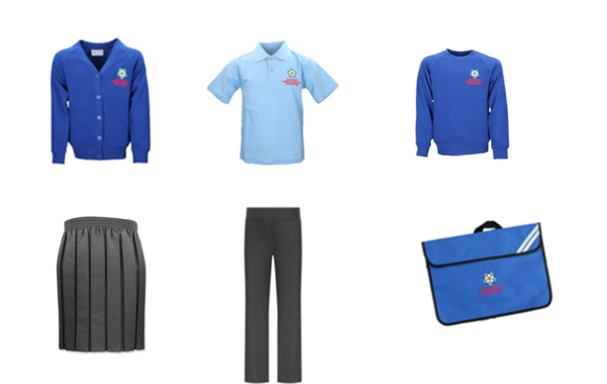
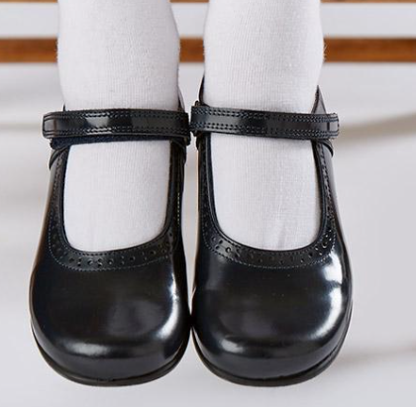
Our School Uniform
St Mary’s Church of England Junior Academy
Pupil Premium Support –
School Uniform
If your child is in receipt of Pupil Premium you are eligible to receive 10% off school uniform costs at Stevensons Outfitters (This is not available to use elsewhere or as a cash alternative).
Please get in contact with Mrs Drake in our school Office if you would like to access this offer.
Notes:
Pupils wear:
• Grey/black or navy skirt/pinafore dress/shorts/trousers or blue and white checked or striped summer dresses (skirts should be at least knee length and of a style which allows the children to sit comfortably on the floor)
• Pale blue blouse, white shirt or polo shirt*
• Royal blue sweatshirt* or cardigan*, without a hood, either plain or with the Academy logo
• Plain white, blue, black or grey short or knee length socks (not over the knee) or
• Black, navy or grey tights
NO Jewellery/make-up or nail varnish, only plain stud earrings (NO hoops)
• Black or navy shorts or trousers not jogging bottoms
Shoes
Shoes – flat, black and appropriate for school.
Trainers – plain without logos. (PE- outdoors)
Sandals – closed in and fastened securely. (No flip flop types in the summer term)
Boots – plain black and not prevent children from sitting comfortably on the floor.
Warm coat with a hood for cold weather – children do go outside when it is cold and wet.
• Grey/black or navy skirt/pinafore dress/shorts/trousers or blue and white checked or striped summer dresses (skirts should be at least knee length and of a style which allows the children to sit comfortably on the floor)
• Pale blue blouse, white shirt or polo shirt*
• Royal blue sweatshirt* or cardigan*, without a hood, either plain or with the Academy logo
• Plain white, blue, black or grey short or knee length socks (not over the knee) or
• Black, navy or grey tights
NO Jewellery/make-up or nail varnish, only plain stud earrings (NO hoops)
• Black or navy shorts or trousers not jogging bottoms
Shoes
Shoes – flat, black and appropriate for school.
Trainers – plain without logos. (PE- outdoors)
Sandals – closed in and fastened securely. (No flip flop types in the summer term)
Boots – plain black and not prevent children from sitting comfortably on the floor.
Warm coat with a hood for cold weather – children do go outside when it is cold and wet.

Slide 24
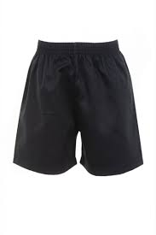

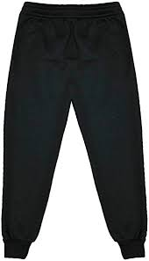

PE Kit
St Mary’s Church of England Junior Academy
From September, all pupils are required to wear a PE kit, on the days they have PE. They will be told when this is in September.
Notes:
P.E. Kit
Children can wear PE clothes and footwear on P.E days.
Unless it is a PE day, please bring in a suitable PE kit.in a draw-string bag for after school club.
All school uniform and P.E. kit MUST be named.
Pupils wear:
• Black or navy shorts
• Plain white T-shirt or polo shirt (long enough to tuck into shorts)
• Plain or school logo Royal blue jumpers can be worn (no other logos, brands or slogans)
• A pair of plimsolls (indoor) – velcro fastenings are useful for younger children
• trainers are needed for outdoor use
• Black or navy jogging bottoms for outdoor lessons in cold weather
No earrings on PE days.
Unless it is a PE day, please bring in a suitable PE kit.in a draw-string bag for after school club.
All school uniform and P.E. kit MUST be named.
Pupils wear:
• Black or navy shorts
• Plain white T-shirt or polo shirt (long enough to tuck into shorts)
• Plain or school logo Royal blue jumpers can be worn (no other logos, brands or slogans)
• A pair of plimsolls (indoor) – velcro fastenings are useful for younger children
• trainers are needed for outdoor use
• Black or navy jogging bottoms for outdoor lessons

Slide 25

Behaviour & Rewards
St Mary’s Church of England Junior Academy
We have clear, consistent boundaries for the children and use restorative practices to repair any minor behaviour incidents.
In September, you will receive a copy of the behaviour policy outlining how we praise children and the consequences given for children who do not adhere to the behaviour policy.
We want to celebrate your child’s achievements both in and out of school so please send these to the school office so these can be shared on our newsletter and Facebook page.
RESTORATIVE CONFERENCING – Used once a child is calm to help reflect on incidence of negative behaviour.
What happened?
What were you thinking/feeling?
What needs to happen to put it right?
What are you going to do differently next time?

Slide 26
How can I help my child?
St Mary’s Church of England Junior Academy
Tell us about your child - YOU KNOW THEM BEST!
Talk to your child’s Class teacher; keep an open dialogue going and share any concerns and feedback.
If your child is on SEN Support or has an EHCP, please attend all the review meetings or let us know if you can’t make it. Look out for our SENDCo Surgery next term to pop in and have a chat.
Contact the school Office to arrange a phone call or meeting with our Pastoral Support Officer if you or your child are struggling or have concerns.
Read with them every day and complete other homework tasks set.
Read the school Newsletter – It’s a good source of information!

Slide 27
Any Questions?
St Mary’s Church of England Junior Academy
Notes:
Thank you for coming - We look forward to getting to know you and your children.

