Slide 1



St Mary’s Church of England Junior Academy
Welcome to St Mary’s
SEN Information Report
Reviewed and Published Feb 2026 Next Review: Sept 2026
Nurture. Respect. Responsible. Community. Compassion. Courage.
St Mary’s DfE number: 926/3053

Slide 2
Contents:
What will I find in this SEN Information Report? | 3 | How does St Mary’s adapt the curriculum and learning environment for children with special educational needs? | 15 | How does St Mary’s support children with special educational needs in their transitions between settings? (From Infant School) | 26
What is a special educational needs? | 4 | How does St Mary’s enable pupils with special educational needs to engage in activities of the school together with children who do not have special educational needs? | 16 | How does St Mary’s support children with special educational needs in their transitions between settings? (To High School) | 27
What are the categories of need? | 5 | What expertise and training have staff had in relation to supporting children with special educational needs? | 17-18 | Where can I find SEND related policies? | 28
What do I do if I think my child has a special educational need or disability? | 6 | What is an Education Health and Care Plan? | 19 | What are the arrangements for complaints from parents of pupils with special educational needs concerning provision made at school? | 29
What is the SEND profile at St Mary’s? | 7 | How do we provide for children with Educational Health and Care Plans (EHCPs)? | 20 | Which other services are involved in meeting the needs of pupils with special educational needs and in supporting families? | 30
How do we identify and assess pupils with special education needs at St Mary’s? | 8-9 | How are Education Health and Care Plans reviewed? | 21 | Contact details of support services for parents of pupils with special educational needs. | 31
How does St Mary’s approach teaching pupils with special educational needs? | 10 | How do St Mary’s use their SEND funding? | 22 | Events for parents | 32
What does a 7Cs SEND Support plan look like? | 11-12 | What support is available for improving Social, Emotional and Mental Health development of pupils with special educational needs? | 23 | SEND Local Offer | 33
How will parents be consulted and involved in arrangements for children with special educational needs? | 13 | What Pastoral Support is available? | 24 | Where can I find out more about St Mary’s? Link to school website | 34
What additional support is available to pupils? | 14 | Mental Health Support Team in Schools (MHSTS) | 25 | Jargon Buster | 35
 |  |  |  | Information available in other formats | 36

Slide 3


St Mary’s Church of England Junior Academy
What will I find in this SEN Information Report?
This should help children and families understand the support and provision available to children and young people with Special Educational Needs and/or Disabilities (SEND).
All schools have a legal duty to make available their
Local SEND Offer to families.
It is a requirement that this is published, and reviewed annually.
The required information is set out in the SEN regulations, which can be found in the SEND Code of Practice. We hope this report is easy to read and family-friendly, your feedback is welcome ☺
Click on our school logo on each page to take you back to the main menu

Slide 4
What is a Special Education Need? The SEN Code of Practice (2015) states:
St Mary’s Church of England Junior Academy
A child or young person has SEND if they have a learning difficulty or disability which calls for special educational provision to be made. A child of compulsory school age or a young person has a learning difficulty or disability if they have:
a significantly greater difficulty in learning than the majority of others the same age,
a disability which prevents or hinders them from making the use of facilities of the kind generally provided for others the same age in mainstream schools or mainstream post-16 institutions.

Slide 5
What are the Categories of Need?
St Mary’s Church of England Junior Academy
COGNITION AND LEARNING Children might; learn at a slower pace find the curriculum difficult struggle with organisation and memory have a specific difficulty in literacy or numeracy | COMMUNICATION AND INTERACTION Children might; struggle to talk or say what they want to find it hard to understand what others are saying find conversations and play confusing and challenging have a diagnosis of ASD
SOCIAL, EMOTIONAL & MENTAL HEALTH DIFFICULTIES (SEMH) Children might: find relationships difficult, appear withdrawn or isolated behave in ways that affect their learning eg. being disruptive or challenging do things that impact on their health and wellbeing have underlying mental health difficulties such as anxiety, depression, self-harming, substance misuse, eating disorders or physical symptoms that are medically unexplained. have disorders eg. ADD, ADHD, attachment disorder that could negatively impact on their SEMH | SENSORY AND / OR PHYSICAL Children might; have a disability such as a visual or hearing impairment a physical difficulty a multi-sensory impairment a medical need which requires adaptations to be made in order to access education

Slide 6
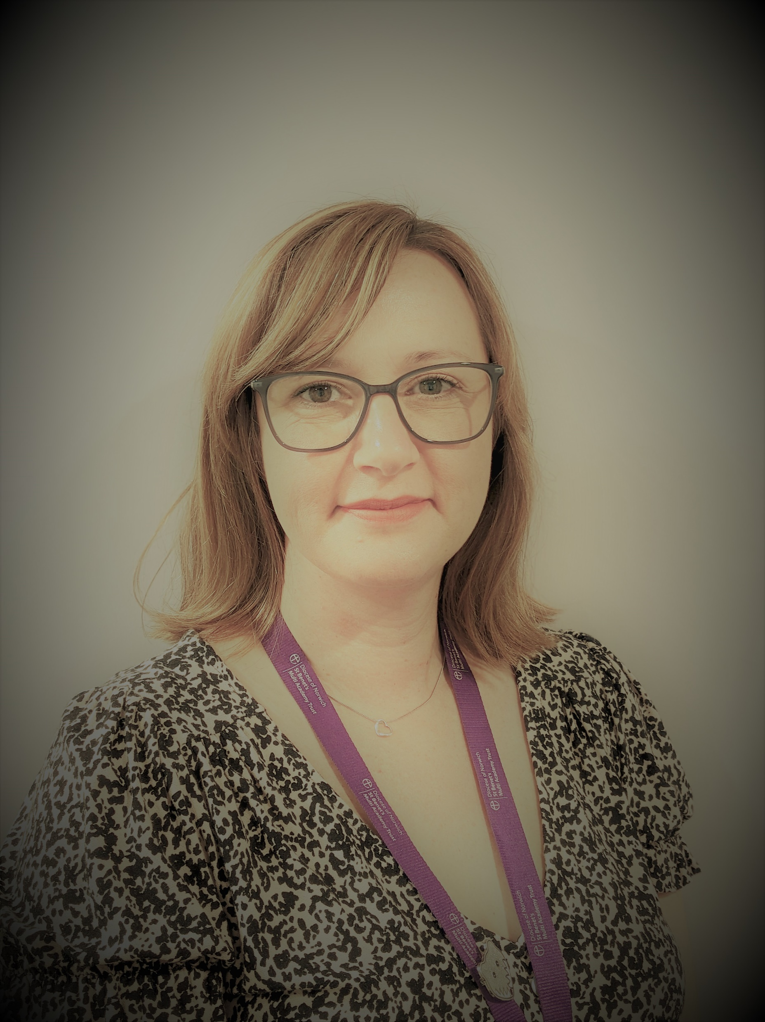
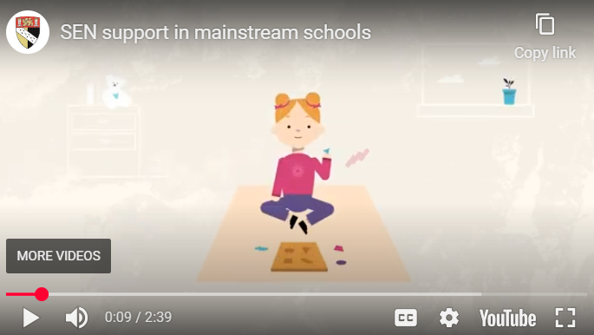

What do I do if I think my child has a special educational need or disability?
St Mary’s Church of England Junior Academy
SENDCO – Mrs Laura Ketley
If you think your child may have special educational needs, please speak to their class teacher in the first instance, then contact Mrs Laura Ketley, our SENDCO.
Contact details are:
 Telephone: 01508 530459
Email: lketley@stmarys.stbenets.org
Address: St. Mary’s Church of England Junior Academy, Swan Lane, Long Stratton, NR15 2UY
Watch this video for more information on SEN
Support in schools.
If you have specific questions about the Norfolk Local Offer please look at the Frequently Asked Questions.

Slide 7
St Mary’s Church of England Junior Academy
What is the SEND profile at St Mary’s?
The below table shows percentages of pupils within our school with SEND.
School Compared to Local & National Data % (Jan 2025)
 |  | School | Trust* | Norfolk* | England*
SEN Support |  | 27 | 14.5 | 14.3 | 14.2
EHCP |  | 10.1 | 5.1 | 5.6 | 5.3
Total SEND |  | 37.1 | 19.6 | 19.9 | 19.5
* Primary & Secondary Schools combined data. See Figure 2
Broad category of need | % of pupils within our school
Social Emotional Mental Health | 29.1 %
Cognition and Learning | 22.3 %
Communication and Interaction | 22.3 %
Sensory and/or Physical | 12.8 %
Some children may have needs in more than one category which are not represented in this data.

Slide 8

St Mary’s Church of England Junior Academy
How do we identify and assess pupils with special educational needs at St Mary’s?
Our learners with SEN are entitled to an education that meets their needs, promotes high standards and helps them to achieve their best. Teachers make adaptations to ensure access to a broad and balanced curriculum for all children in their class through quality first teaching.
Our identification process is illustrated in our Identifying SEND using 7C Flow Chart .
Once a child with SEND has been identified, St Mary’s uses the graduated approach (Assess/Plan/Do/ Review) to meet individual needs by:
Clearly assessing each child’s needs every term using the 7Cs approach.
Working with your child’s teacher, SENDCO, parents and listening to your child, in order to assess their needs.
Together, creating an Individual SEN Support Plan which outlines support, adjustments and interventions to help your child make progress.
Parent/ Teacher/ Pupil SEN meetings every term to together review how provision is meeting needs, and making any necessary changes.

Slide 9
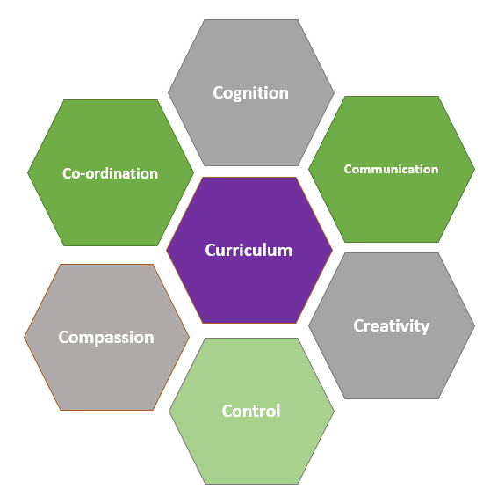


St Mary’s Church of England Junior Academy
At St Mary’s, we use the 7Cs Strengths based approach which aims to target and support underlying barriers to learning. The 7Cs broad areas of need include: Cognition, Communication, Creativity, Control, Compassion, Co-ordination and Curriculum.
Impact of SEN provision is measured using a 7Cs tracker which enables us to capture
small steps of progress and to plan for next steps and future provision.
Every child’s progress in English and maths (including children with SEN where possible) is also assessed and measured using PiXL and recorded on Pupil Asset. This helps us to check how well we are supporting your child’s progress and to draw comparisons with other schools.
We also make use of specialist SEN assessment tools such as the Salford Sentence and Reading Comprehension Test, Sandwell Maths, PhAB 2 (phonological awareness assessment) and the British Picture Vocabulary Scale (BPVS) to assess language needs.
These tools also help us to identify gaps in knowledge and understanding and plan focus groups for targeted interventions.
Our teachers also use various strategies to adapt access and remove barriers to learning using guidance from the Norfolk Provision Expected At SEN Support (PEASS) document.

Slide 10


St Mary’s Church of England Junior Academy
How does St Mary’s approach teaching pupils with special educational needs?
We strive to be an inclusive school and want all children to participate in all areas of learning.
We have high aspirations for all children and aim to create a learning environment which is flexible in meeting the needs of all children and which supports them to make the best possible progress.
We offer a broad and balanced curriculum and aim for a high quality teaching approach.
We aim to include all children by adapting ‘the learning journey’.
All children on the SEN record have an Individual SEN Support Plan which outlines adaptations in teaching strategies and support such as small step instructions, visual aids and additional adult check ins.
Lesson transitions are supported through every classroom having a consistent visual timetable with consistent symbols used throughout the school. We use Widget symbols which are available online.

Slide 11
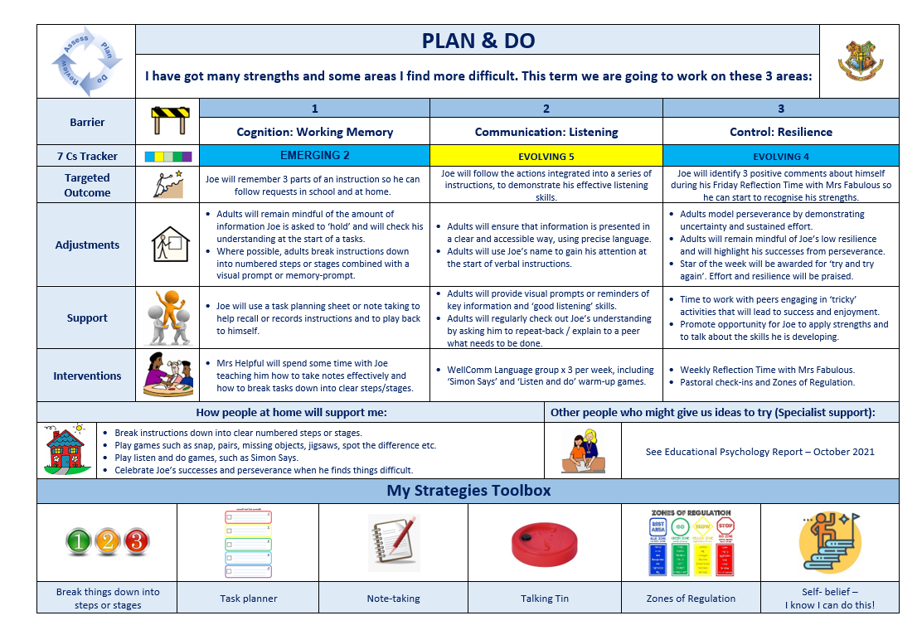
What does a 7Cs SEND Support Plan look like?
St Mary’s Church of England Junior Academy
An example of what a 7Cs SEND support plan may look like for your child.

Slide 12
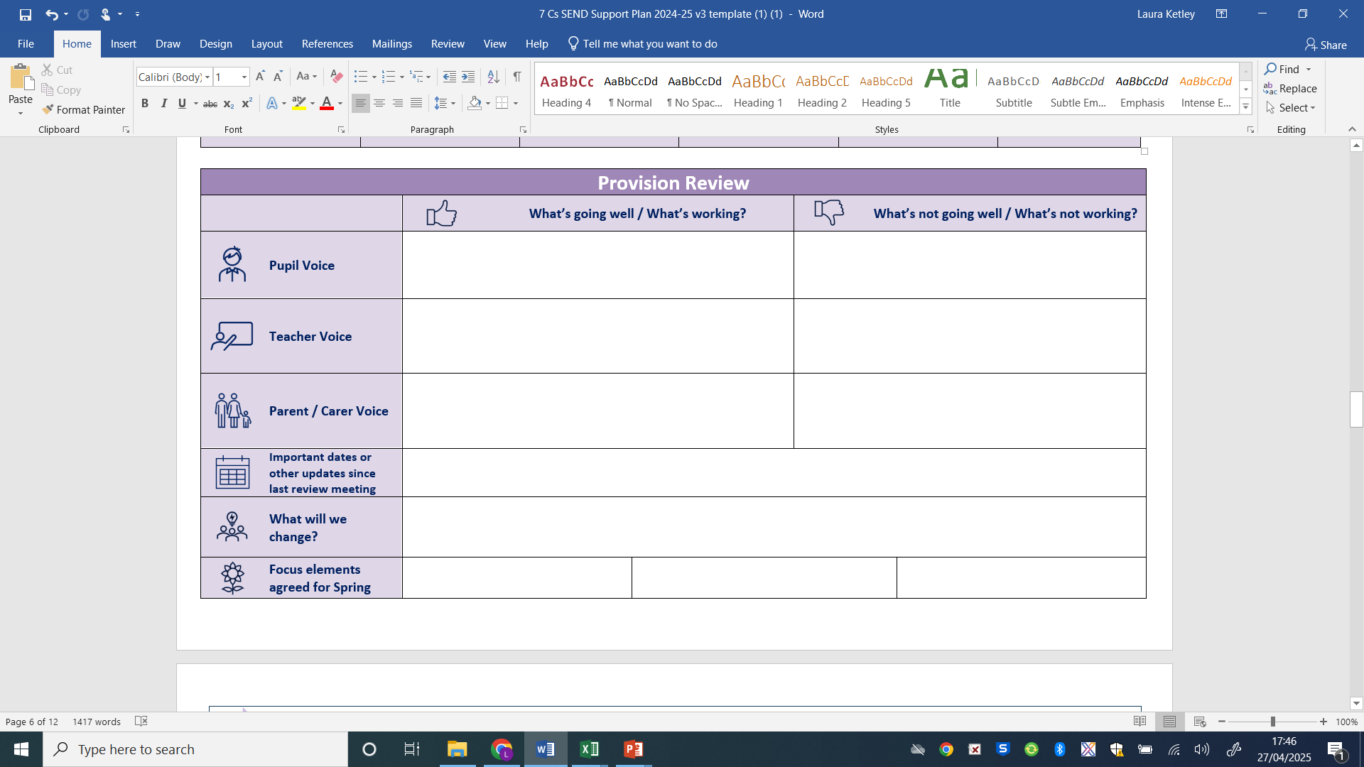
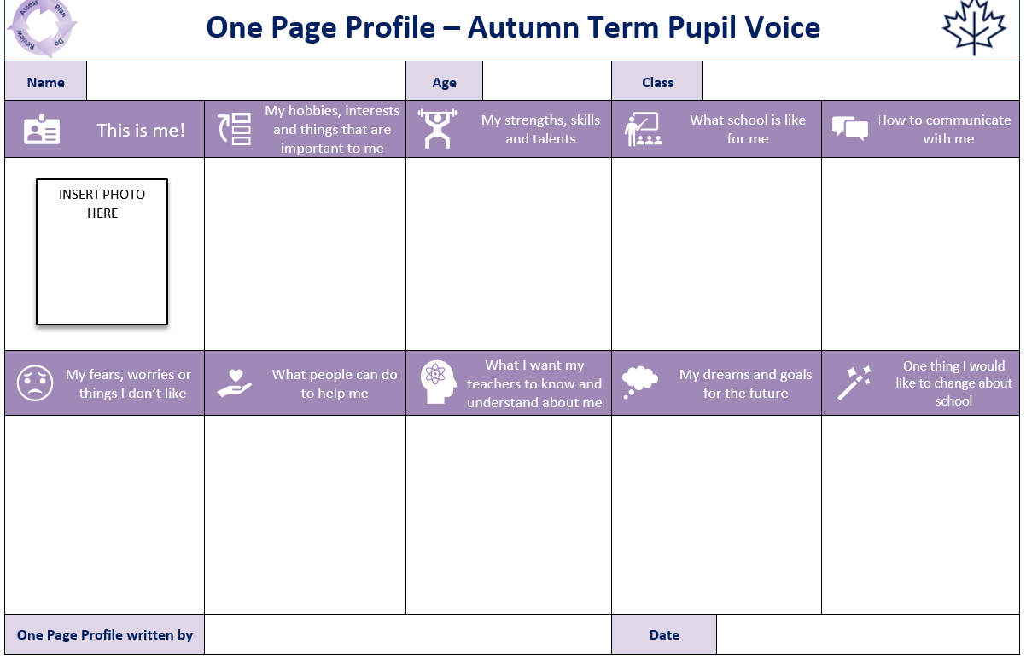
St Mary’s Church of England Junior Academy
An integral part of the assess, plan, do, review process is gathering pupil voice and parent views so that we can all work together to plan for the needs of your child.
Plans are updated termly and you will be invited to attend a review meeting with the teacher and your child at the end of each term.

Slide 13


How will parents be consulted and involved in arrangements for children with special educational needs?
St Mary’s Church of England Junior Academy
We value working with families and listening to parent and child views. This is how we collect your views:
Termly Parent/ Teacher / Pupil SEN meeting, where together you review SEN provision and children’s SEN Support Plans every term. This is in addition to two Parent Teacher meetings.
Parent Surveys are sent to parents every term with SEND forming part of the survey.
Children’s class teachers and the SENDCO are available before school on the playground on a day-to-day basis for face-to-face conversations (8:40-8:50am) and there are always two members of staff on the gate at drop off and pick up times.
You are welcome to arrange a longer conversation by emailing the class teacher, SENDCO or School Office.
The School Office contact details are:  Telephone: 01508 530459 Email: office@stmarys.stbenets .org

Slide 14
St Mary’s Church of England Junior Academy
What additional support is available to pupils?
Support: Talk partners, modelled language skills, implicit made explicit, specific responsibilities.
Therapies and interventions: Speech and Language therapy, specific learning interventions, SEMH support.
Specialist equipment: sensory aids (e.g. noise cancelling headphones), chew bracelets, assistive technology such as touch typing key boards.
Physical environment: quiet areas to minimise environmental distractions, The Temple break and lunch time nurture space, personalised learning space with a smaller class size.
TIER 1
Universal provision
TIER 2
Early Intervention
TIER 3
Targeted Support & Investigation of Needs
TIER 4
Intensive SEND Support
TIER 5
EHCP
Click on here to view our whole school provision map on our website. Here you will find details of specific support, resources and training to meet the needs of our pupils with SEND.

Slide 15




St Mary’s Church of England Junior Academy
How does St Mary’s adapt the curriculum and learning environment for children with special educational needs?
Written information is made more accessible through using larger text, visual aids and key vocabulary lists.
The curriculum is adapted through changes to classroom organisation including seating plans, timetabling ‘catch up groups’ and providing additional time.
Technology is used to make the curriculum more accessible including access to Chromebooks to aid longer pieces of writing, alternative recording devices and talking tins.
The curriculum is adapted for children with ongoing medical of health needs, such as vision impairments, such as providing enlarged text, own desk copies, desk slopes and rest breaks.
The physical environment is adapted through tailored seating arrangements, signage, lifts to aid movement across the school, accessible and adapted toilets, walkways and specific spaces for quiet or small group learning.

Slide 16
St Mary’s Church of England Junior Academy
How does St Mary’s enable pupils with special educational needs to engage in activities of the school together with children who do not have special educational needs?
External Sporting events
Forest School
Subject Ambassadors
School Council
Rock Steady Music Lessons
Bikeability
Eco Council
Local community visits and events
Educational visits
Residential visits
At St Mary’s our passion and ambition is to see all children and young people achieve excellent educational outcomes alongside developing and growing into their potential as individuals. Our culture is one of high aspiration for all. This is rooted in our Christian values Nurture, Respect, Responsible, Community, Compassion and Courage.
Our vision of "Life in all its fullness" means that inclusion is woven into the very fabric of our curriculum and daily life. Whether through our collective worship, our adaptive teaching methods, or our pastoral care, we aim to build a courageous community where no one is left behind.
We believe that:
• All pupils with SEND are entitled to a broad and balanced curriculum
• Pupils’ learning occurs alongside their emotional, physical and spiritual development.
These are some examples of the opportunities available at St Mary’s.

Slide 17
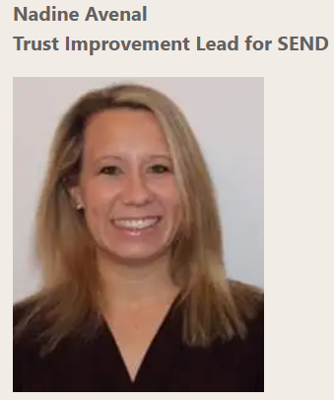
What expertise and training have staff had in relation to supporting children with special educational needs?
St Mary’s Church of England Junior Academy
The SENDCO attends half-termly SEND Network meetings where we benefit from the expertise of (Mrs) Nadine Avenal, Trust Improvement Lead for SEND, St Benet’s Multi Academy Trust. These are cascaded back to school staff. There are also opportunities to visit other mainstream and complex needs settings in order to develop our practice back at St Mary’s.
Teachers attend termly SEND training sessions, led by the SENDCO which focus on embedding the 7Cs Graduated Approach, whole-school SEND priorities as identified in our Academy Improvement and Development Plan (AIDP) and the needs of our cohort through continuously striving to drive SEND inclusive practice.
SENDCO Professional Links
and Training
Our experienced SENDCO began the role in September 2018 in two other St Benet’s schools. She has completed the National Award for SEN Coordination as well as the National Professional Qualification In Headship.
She attends termly Norfolk SEND Forums to ensure up-to-date knowledge of SEND policy and practice.
As part of multi-agency approaches to SEND, she attends termly Core Consultations and NHS Speech and Language Link meetings.
Our SENDCO’s other responsibilities include:
Medical Needs
Designated Teacher for Looked after Children
Mental Health Champion
Deputy Designated Safeguarding Lead (DDSL)

Slide 18
Recent SEND training opportunities - in the last 2 years
St Mary’s Church of England Junior Academy
Cognition and Learning | Communication and Interaction
Clicker 8 training – on-going through Access Through Technology Dyslexia Awareness training by the Dyslexia Outreach Service Adaptive teaching – SEND Station 10.7.24 | Making Sense of Autism - January 2026 Blank Level Questioning – November 2024 Social Stories and Comic Strip Conversations – The Wherry School Nov 2024
Social, Emotional and Mental Health | Physical and Sensory
ACES and Trauma Informed Practice Strategies to support trauma – Beacon House Emotional Literacy Support (ELSA) Play Therapy – 25.3.25 Domestic Abuse Champion Mental Health Champion – Senior Leadership Early Help Assessment Plans (EHAP) Norfolk Steps –Positive Behaviour Management – January 2026 Norfolk Steps Tutor Training - Nov 2025 Designated Safeguarding Lead Refresher Training – Jan 2025 Zones of Regulation – 4.7.24 | Sensory Circuits 14.9.23 and 3.3.25 First Aid Anaphylaxis and Allergy Awareness – Jan 2025 Adrenaline Auto injector Training - Jan 2025 Diabetes Training – September 2025
Future scheduled training
Practical ideas to support Cognition and Learning needs – Parkside School June 2025
WellComm – Introduction to WellComm Digital to support speech and language needs
Lego Therapy – training for staff who are new to the programme.

Slide 19
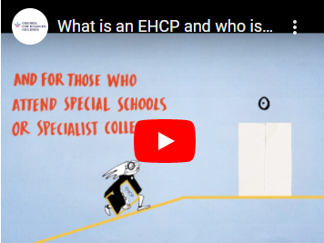
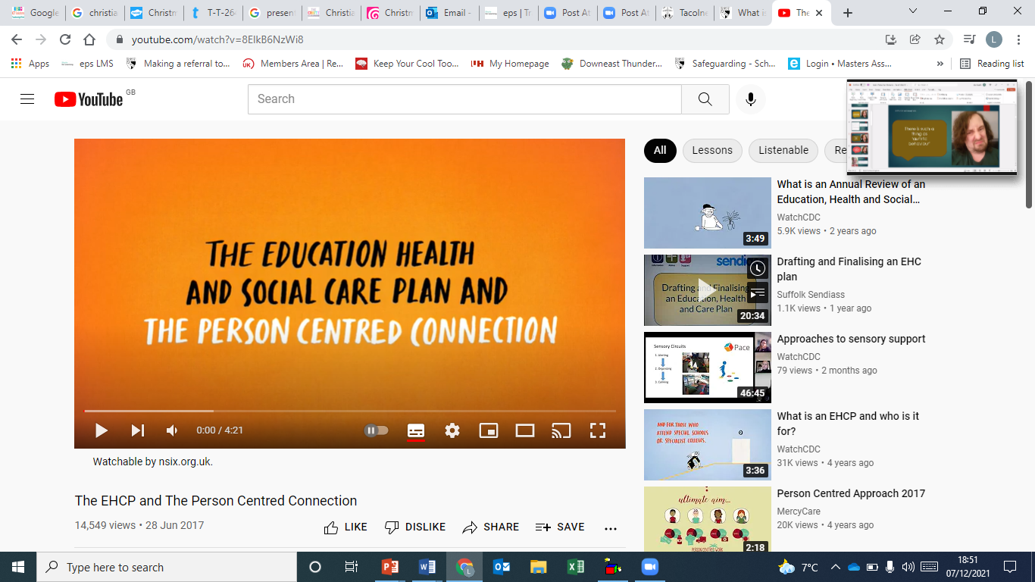
St Mary’s Church of England Junior Academy
What is an Education Health and Care Plan?
Most children and young people with special educational needs (SEN) will have their needs met with SEN Support in our setting. Some children may require an Education, Health and Care needs assessment in order for the local authority to decide whether it is necessary for them to make a higher level of provision in accordance with an Education Health and Care Plan (EHCP) to secure the best possible outcomes for a child’s future. An EHCP is for under 25s with complex special educational needs and disabilities (SEND).
The two videos here help to explain the purpose and the process in more detail.
What is an EHCP? The Person - Centred Approach

Slide 20
St Mary’s Church of England Junior Academy
How do we provide for children with Educational Health and Care Plans (EHCPs)?
We use our best endeavours to follow advice from relevant professionals, as set out in the EHCP. We take information from the needs, provision and outcomes sections of the EHCP and use these to compile an Assess/Plan/Do/Review (APDR) plan each term with some smaller stepped, achievable targets.
Each child has an EHCP Learning Portfolio so that we can collect evidence of progress towards targets. Children with EHCPs may receive specific intervention as well as provision within the classroom to meet their needs.
All adults working with any children with an EHCP are made aware of the pupil’s needs and that all reasonable provisions are put in place to meet them. We review the EHCP APDR plans termly just like our SEND Support plans.
Call the SEND and inclusion support line to see if an EHCP is appropriate for you child on ​0333 313 7165 or the Norfolk EHCP family advice line on 01603 679183

Slide 21
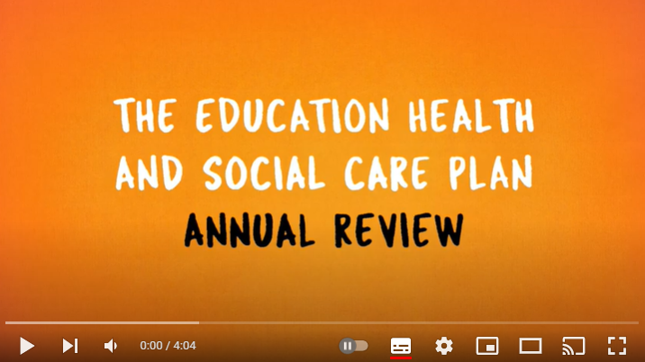
How are Education Health and Care Plans reviewed?
St Mary’s Church of England Junior Academy
If a child in our school has an EHCP, the local authority must review it at least once a year. An annual review meeting will take place which requires everyone involved with the child to meet together.
It will consider:
The progress towards achieving the outcomes written in the EHC plan
the views, wishes and feelings of children and their parent carer
Whether anything has changed
We will arrange the annual review on the local authority's behalf and send out invitations to those who should attend. Professionals from external services may also attend the review meeting. If there is concern about progress of a child, the parent carer or school may request that the review be arranged sooner than planned.
If your child or young person has an EHCP and is due to move from one stage of schooling to another; early years to school, primary to secondary, then the local authority (LA) has a legal duty to review and amend your child’s EHCP to name the new education setting. This is called ‘Phase Transfer’ and will happen in the autumn term the year before your child is due to move to a new phase of education.
What happens at an EHCP annual review?

Slide 22

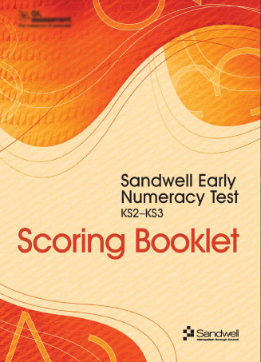

How do St Mary’s use their SEND funding?
St Mary’s Church of England Junior Academy
Our current SEND Funding information can be seen on our SEN Memorandum 2025/2026 here
SEND funding from last academic year was used to maintain our Personalised Provision room and SEMH Nurture provision: It funded an additional pastoral assistant so that we could provide lunch time support in the Nurture Room and Forest School provision and a mentor from The Benjamin Foundation service.
SEND funding this current year will be used to maintain our Personalised Provision Room and will provide resources for pupils to access in class to support their cognition and learning needs such as the Literacy Gold online intervention. WellComm will be introduced to screen speech, language and communication needs. We have also used our funding to purchase interventions for Cognition and Learning such at Number Stacks Maths intervention and Memory Fix to support working memory difficulties.
SEND funding next year will be as well as maintaining our Personalised Provision Room if budgets allow. This is dependent on the number of pupils with SEND joining our school in September.
Top-up funding (Element 3) is also used to provide additional adult support for children with high SEN needs and to support pupils with their Social, Emotional and Mental Health Needs.

Slide 23

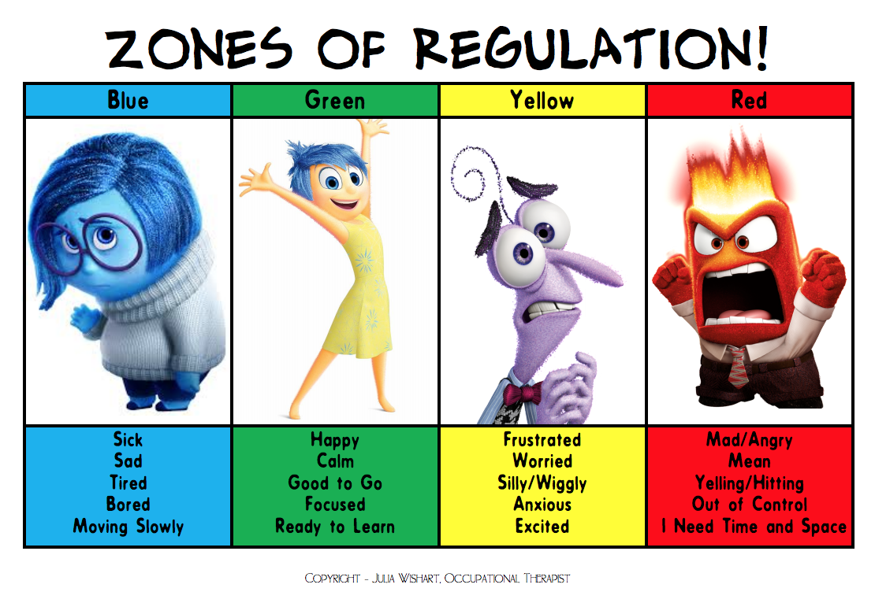
St Mary’s Church of England Junior Academy
What support is available for improving Social, Emotional and Mental Health development of pupils with special educational needs?
We strive to be an inclusive and nurturing setting with caring staff who build positive relationships with all children. Mental health and wellbeing is taught throughout our PSHE curriculum.
We have two Full-Time Pastoral Support Officers who are dedicated to supporting families and children’s pastoral needs through 1:1 sessions, check ins, additional support, lunchtime nurture clubs, forest school sessions and completing ‘wishes and feelings’. More information can be found on the next slide.
‘The Wellbeing Hub’, a lunchtime Nurture space.
We have a Mental Health Champion.
Zones of Regulation is used through the school and there are displays in every
classroom.

Slide 24
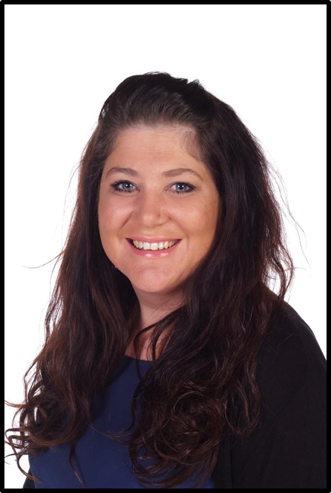
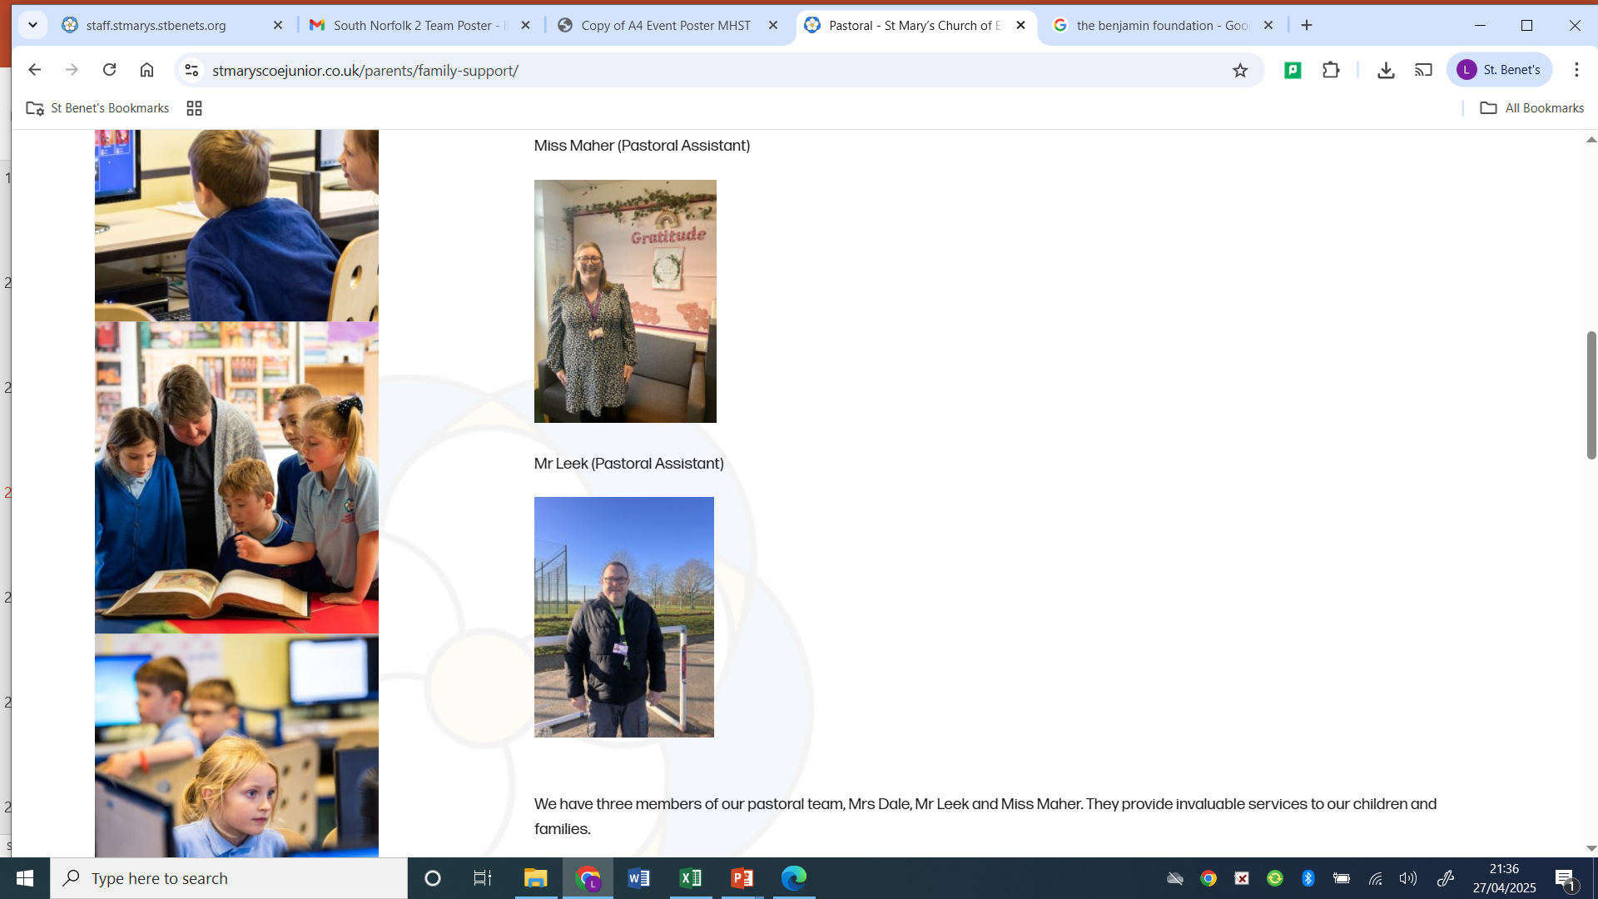
What Pastoral Support is available?
St Mary’s Church of England Junior Academy
Mrs Dale is our Pastoral Lead, Safeguarding Lead and Mental Health Champion.
She can be contacted by email: tdale@stmarys.stbenets.org or via the school Office (01508 530459).
Miss Maher runs our nurture interventions. Each day focuses on a different need such as bereavement, friendships, bullying, social and emotional and Young Carers.
The team are available to work with pupils and families to support a whole range of areas including mental health support, financial guidance, family support and sign-posting to other support services.
Both officers are ELSA trained. https://www.elsa-support.co.uk/

Slide 25
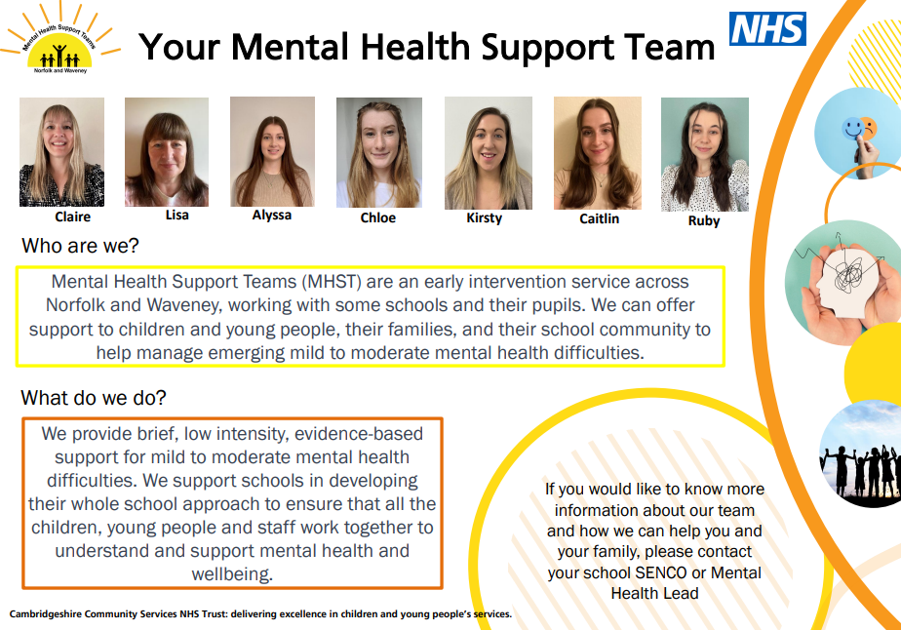
Mental Health Support Team in Schools (MHSTS)
St Mary’s Church of England Junior Academy
We work closely with the Mental Health Support Team in Schools (MHSTS) who provide workshops on a whole school level and also targeted support for parents so that they can support the mental health needs of their children.
At a whole school level, transition workshops are planned in for the Summer term for our Y6 pupils. Workshops on feelings and emotions and friendships are also on offer.

Slide 26

How does St Mary’s support children with special educational needs in their transitions between settings?
St Mary’s Church of England Junior Academy
Transition to Year 3:
Our main feeder school is Manor Field Infant and Nursery School. Children at the Infant School with special education needs benefit from an enhanced transition package, before attending their first day in September in Year 3. St Mary’s SENDCO works closely with the Infant School SENDCO, to begin preparing for upcoming needs, 6 months or more beforehand. The SENDCO also holds an event for perspective parents in June/July, in order to meet staff and to begin building a relationship and sharing key information. See the flow chart for further information on the transition process for Y2 pupils with SEND.
Class teacher visits all Y2 pupils in classes.
Assembly at Manor Field with Miss Richardson for all Y2s.
Y2 pupils with SEND visit St Mary’s in small groups for a personalised tour of the school.
Y2 pupils with SEND attend a Forest School session in a small group.
Soft Play session for all Y2 pupils at Bananas (Long Stratton Leisure Centre)
Opportunity to build in extra transition support for pupils with EHCPs and high SEND needs.
Headteacher and SENDCO at St Mary’s invites parents of Y2 pupils to attend an information session.
Headteacher writes to parents of all Y2 pupils to inform them of transition arrangements.
SENDCO from St Mary’s meets SENDCO at Manor Field to make transition arrangements.
SENDCO at Manor Field identifies those needing extra transition support from School and Community team and makes referrals.
SENDCO at St Mary’s meets with SENDCO at Manor Field for SEND handover of information to inform future planning.
Two transition days at St Mary’s for all Y2 pupils
Y2 teacher and SENCO to complete Transition Passports with Y2 pupils with SEND to gain pupil voice.

Slide 27

How does St Mary’s support children with special educational needs in their transitions between settings?
St Mary’s Church of England Junior Academy
Transition to High School:
Our main feeder school, Long Stratton High School holds additional transition sessions specifically for children with SEN or other children who may benefit from extra visits. Children with SEN benefit from additional visits in a smaller group. St Mary’s SENDCO also works closely with Long Stratton High School SENDCO, and attends regular SENDCO Network meetings in order to work together and continue enhancing this process, for the benefit of the children.
We also work with external services to provide enhanced transition activities for pupils with SEND including the YESS Project, and the School and Community Team. TITAN (Travel Independence Training across Norfolk) offers young people with special educational needs and disabilities (SEND) support to help them to become confident independent travellers.
Flow Chart to show transition process to High School
Headteacher and SENDCO meet to plan transition for all Y6 pupils.
SENDCO makes referrals to the School and Communities Team, the YESS Project and Titan Travel training.
Transition support from external services begins.
Enhanced transition visits to LSHS or other forwarding schools
SENDCO visits St Mary’s to meetY6 pupils with SEND.
SENDCO from St Mary’s meets with SENDCO at LSHS to discuss transition arrangements.
All of Y6 attend two transition days at LSHS or forwarding school.
All pupils in Y5 attend a taster session at LSHS and have further opportunities in Y5/6 to attend wider school events.

Slide 28

St Mary’s Church of England Junior Academy
Where can I find SEND related policies?
SEND Policy
SEND Key Information
Accessibility plan
Safeguarding policy and procedures
Behaviour policy
Complaints procedure
How we support pupils with medical conditions
Admission arrangements
Equality information and objectives

Slide 29

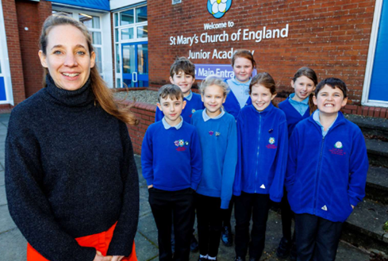
What are the arrangements for complaints from parents of pupils with special educational needs concerning provision made at school?
St Mary’s Church of England Junior Academy
If parents are not happy with the provision made available for your child, we encourage you to bring this to our attention and so we can work together to listen to your concerns and make reasonable adjustments.
If after consultation with the class teacher and SENDCO, the concern has still not been resolved, you may wish to contact the Head Teacher Miss Laura Richardson.
Miss Richardson: lrichardson@stmarys.stbenets.org
If you are still not happy, you may wish to make a formal complaint. Here is the hyperlink:
St Mary’s Complaints Procedure
If you would like support with making a formal complaint to the school, you may contact Hannah Monk, Head of Governance by emailing: hannah.monk@donesc.org

Slide 30



Which other services are involved in meeting the needs of pupils with special educational needs and in supporting families?
St Mary’s Church of England Junior Academy
Educational services include: Virtual School Sensory Support (who support and provide equipment for children with visual or hearing impairments), Educational Psychology Specialist Support, SEND and Inclusion Team, School and Community Team, Access Through Technology, Medical Needs team
Health Services: Just One Norfolk, NHS Speech and Language Therapy Services, Occupational Therapy.
Social Care Services: Early Help, Family Support Service.
Third Sector Services: Nelson’s Journey for support with bereavement, Carers Matter Norfolk.

Slide 31



Contact details of support services for parents of pupils with special educational needs.
St Mary’s Church of England Junior Academy
Norfolk SEND Information - SENDIASS offer free and impartial information, advice and support about special educational needs & disabilities (SEND) for children, young people, parents and carers.
If your child is struggling at school and you need help and advice to get the right support, contact our SEND and Inclusion Support Line on 0333 313 7165. The friendly team of knowledgeable advisers can give you guidance and help you get support. This includes advice and guidance if you're considering applying for an Education, Health and Care Plan (EHCP), and help if you're concerned your child is at risk of exclusion from school. The SEND and Inclusion Support Line is open Monday to Friday, from 9am to 5pm, excluding bank holidays.
The Norfolk Community Directory contains activities, services and groups to help all Norfolk residents live healthy, active and fulfilling lives. You should find something to help you, whether you want to: keep healthy, be sociable, physically active, mentally active, raise your aspirations for educational achievement, help your community, stay independent, feel included, get involved, improve your well-being, stay safe, find suitable care and support, find help to look after your children, or get family support.

Slide 32

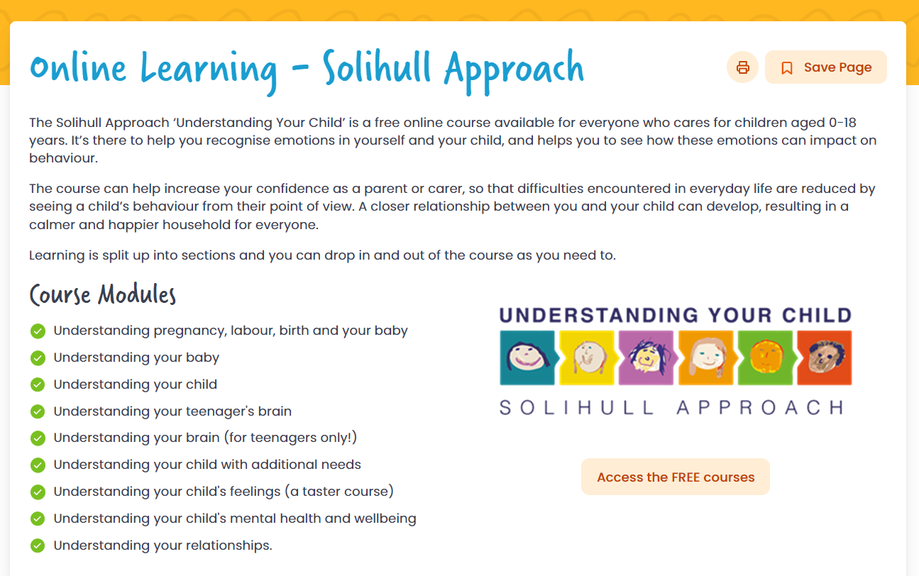

Events for Parents
St Mary’s Church of England Junior Academy
Workshops
Throughout the year we host workshops for Parents which are led by the Mental Health Support Team in Schools (MHSTS) and the School and Community Team (SCT). These cover a range of topics including understanding and managing behaviour and anxiety in children. We send all parents a message about these about 2/3weeks in advance and you can sign up to attend. Refreshments are provided and little ones are welcome.
Available to download for FREE using code: JON70
www.justonenorfolk.nhs.uk/online-learning
Parent SEND Cafés
We host half-termly cafés at St Mary’s covering a range of topics requested by parents. We invite local external support agencies to offer guidance and support and they offer a good opportunity to meet with other families who have children with SEND and share experiences. Refreshments are provided and little ones are welcome.
Termly Reviews
Each term parents are invited to attend a SEND review meeting with the class teacher to review the provision and targets set for your child. Your children are welcome to attend. Local support agencies such as SENDIASS, SCT and MHSTS are available to offer further support and guidance.
Notes:
Would like to highlight some brilliant online courses aimed at parents – currently free to download using the code JON70. Split into modules so can do at your own pace – Really good tips and advice for all stages of parenthood.

Slide 33


SEND Local Offer
St Mary’s Church of England Junior Academy
www.norfolk.gov.uk/children-and-families/send-local-offer

Slide 34

Where can I find out more?
St Mary’s Church of England Junior Academy
www.stmaryscoejunior.co.uk
Notes:
Lots of useful information available on our school website

Slide 35
Jargon Buster
St Mary’s Church of England Junior Academy
APDR – Assess/Plan/Do/Review
EHCP – Education, Health and Care Plan
LA – Local Authority
MHSTS – Mental Health Support Team in Schools
Pastoral Team – Responsible for support with personal problems
PEASS – Provision Expected at SEN Support
PiXL – As assessment tool used for reading, writing and maths
SCT – School and Community Team
SEMH – Social, Emotional and Mental Health Needs
SEN – Special Educational Needs
SEND – Special Educational Needs and Disabilities.
SENDCO – Special Educational Needs Co-ordinator
Universal Provision – support and resources available to all pupils
Zones of Regulation – A system used to support understanding of feelings and emotions and what to do to help yourself

Slide 36
St Mary’s Church of England Junior Academy
This information is available in other formats (Large print, other languages etc). Please ask if you require this.
Thank you
Nurture. Respect. Responsible. Community. Compassion. Courage.

