Slide 1
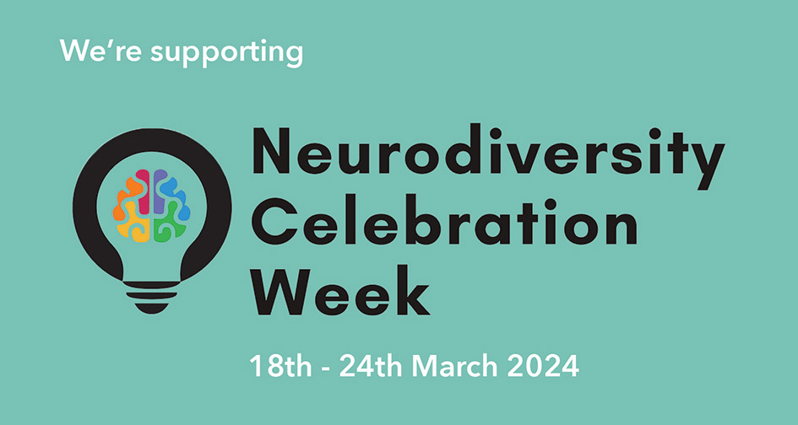

Slide 2
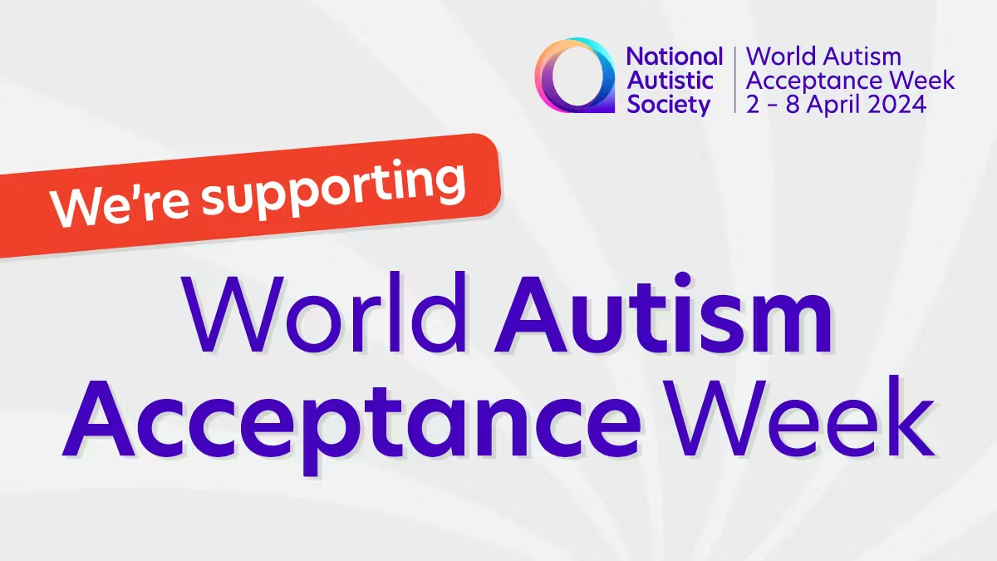

Slide 3
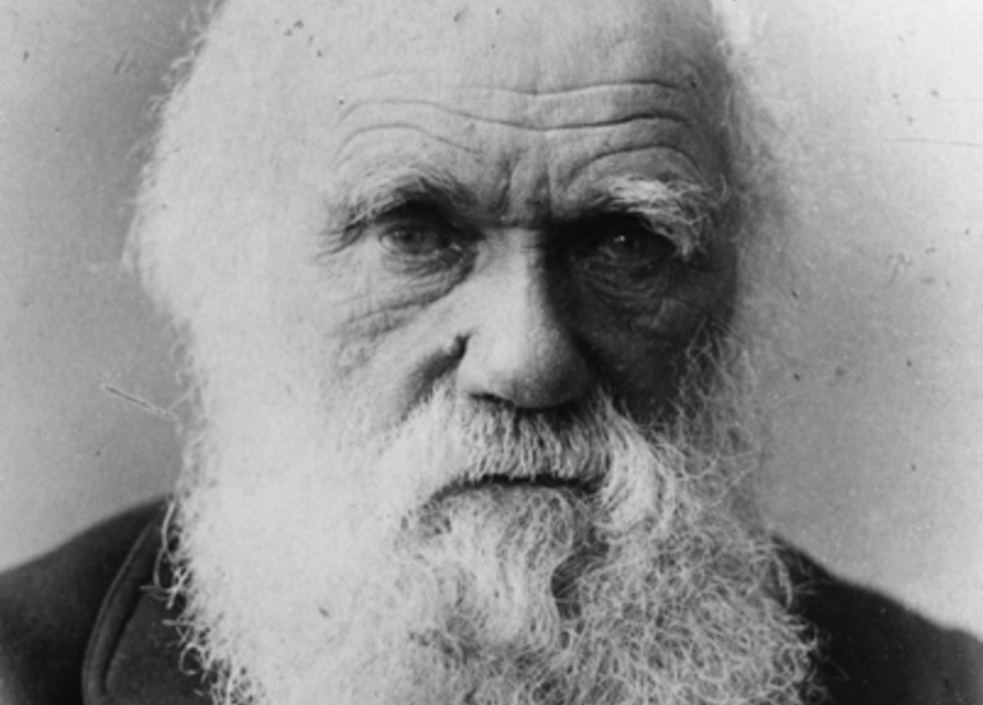
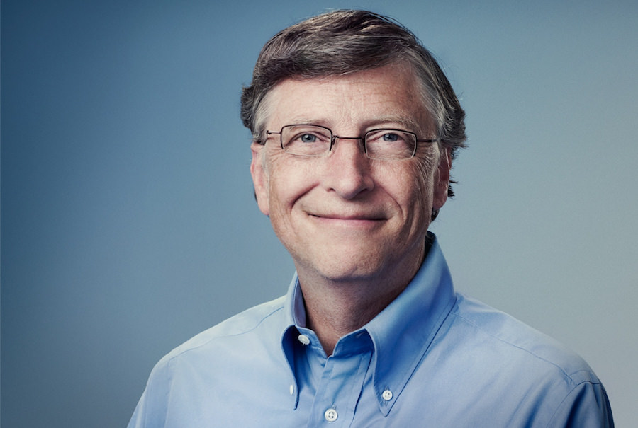
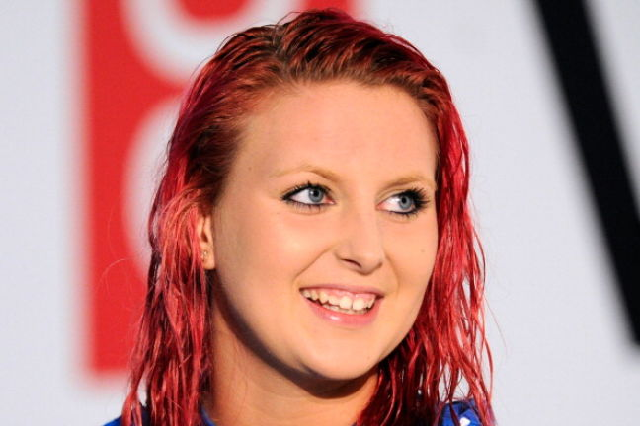
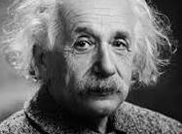
Charles Darwin – Biologist
Bill Gates – Founder of Microsoft
What do all these successful, famous people have in common?
Jessica Applegate – Paralympic Swimmer
Albert Einstein
- Physicist

Slide 4
Charles Darwin - Scientist
Bill Gates – Founder of Microsoft
Every one was or is on the autistic spectrum.
Jessica Applegate – Paralympic Swimmer
Albert Einstein
- Physicist

Slide 5
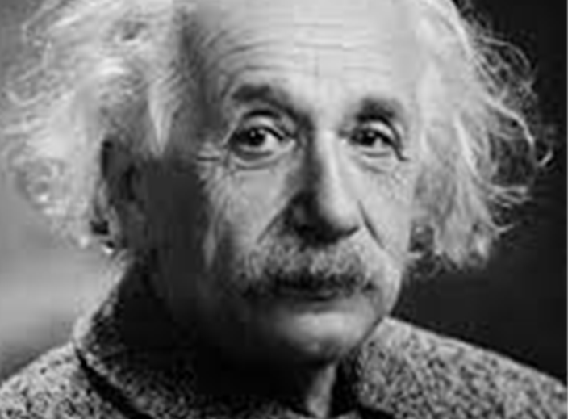
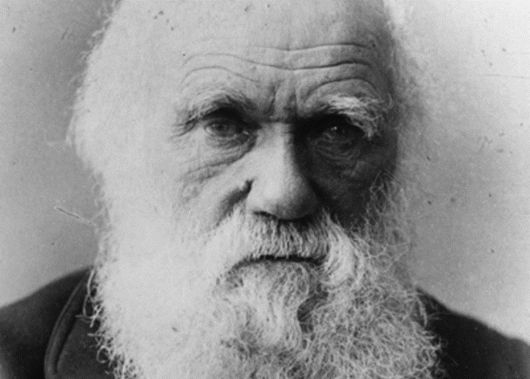
It’s because of the ability of people with high functioning ASD to see things differently that we have some of our world’s greatest achievements.
The Theory of Relativity
FACT: People with ASD may be non-verbal, or take longer than other children to learn to talk. Einstein didn’t speak a word until he was five.
The Theory of Evolution

Slide 6
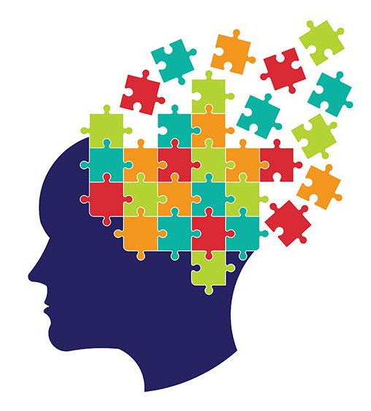
What does that mean?
Being on the autistic spectrum is so common and the ways people behave varies so widely, that it’s very hard to describe what a person with ASD (autistic spectrum disorder) might be like. Everyone is unique.
Not everyone with ASD is a maths or science genius, like Einstein, just like not everyone without ASD isn’t. However, there are a few common traits that many
people diagnosed with ASD tend to share.
Notes:
TEACHER NOTE - Clip one is for KS3
Clip two is for KS4 and KS5

Slide 7
1% of entire world population
High functioning autism (was called Asperger’s)
Classic Autism

Slide 8
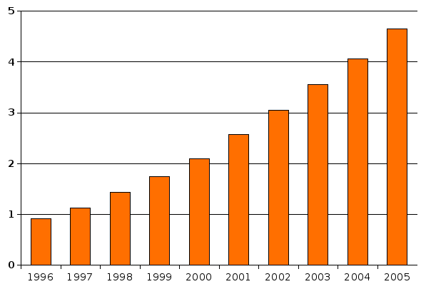
One thing we do know, is that for many years now the amount of people being diagnosed as being on the autistic spectrum is rising. This is most likely because with greater awareness, more cases are being reported.
There are currently more than 700,000 people in the UK with an ASD diagnosis. This number is rising, daily.

Slide 9
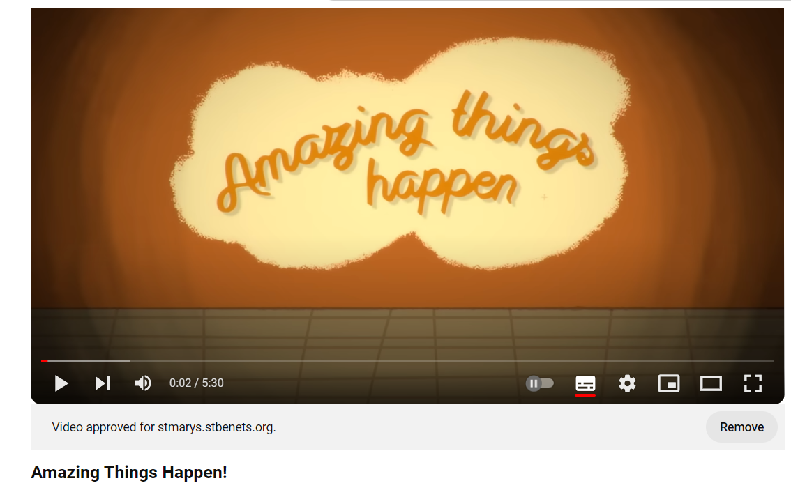
https://youtu.be/Ezv85LMFx2E

Slide 10
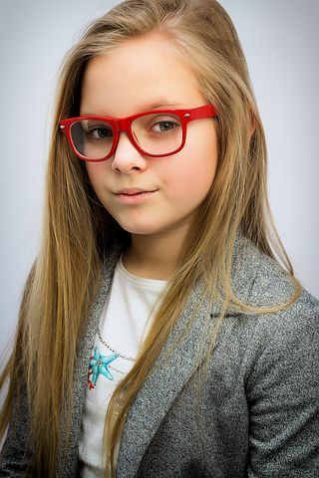
So why are we talking about ASD today?
In our school, we all know someone on the autistic spectrum. You may be yourself. This doesn’t mean that we need to treat people with ASD very differently, or make a big deal about it. However, it is important to be aware that ASD exists and can mean that some people act differently or may want to be supported in different ways to others.
Of course they may not need or want any support at all.
However, it is natural to want to be considerate to people’s needs. Usually we say, treat others how you would like to be treated – but people with autism might not always want to be treated the way someone else does. Not sure if they want the ball
thrown at them to join in with the game? Ask first!
The important thing is we are all a valued
part of this school community and we all
respect each other.

